Slide 1
Quantitative Biological Research with Python (92847)
TA 10 – Statistics

Slide 2
Outline
Motivation & Introduction
P-values
Statistical tests
Caveats
Extensions
Multiple hypothesis testing
Summary

Slide 3
“There are three kinds of lies: lies, damned lies, and statistics”
-- Mark Twain

Slide 4
Why statistical analysis?
Biology is filled with noise
Often hides biological phenomena (“signal”)
Sometimes creates random patterns
The goal: telling signal (true phenomena) from noise

Slide 5
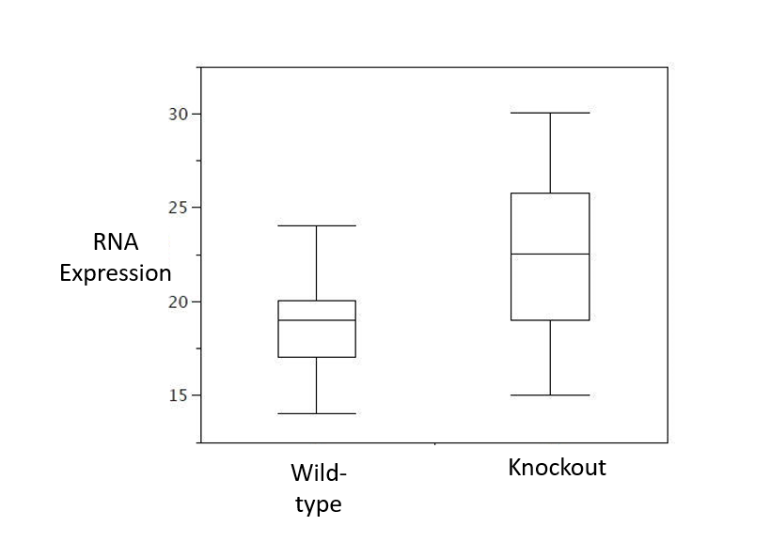
Are the results below signal or noise?

Slide 6
Hypothesis testing in statistics
Formulate the null hypothesis (H₀) – the “default” theory (typically, no effect/association)
The inverse of H₀ is H₁ – the alternative hypothesis
Example: a coin is unbiased (H₀) vs. biased coin (H₁)
We would like to test H₀ by examining collected data
If the collected data appears very unlikely under H₀, we will tend to reject it
Unless we have good reasons to privilege H₀ over H₁

Slide 7

As a researcher, YOU are the defender of the null hypothesis!

Slide 8
Motivation & Introduction
P-values
Statistical tests
Caveats
Extensions
Multiple hypothesis testing
Summary

Slide 9
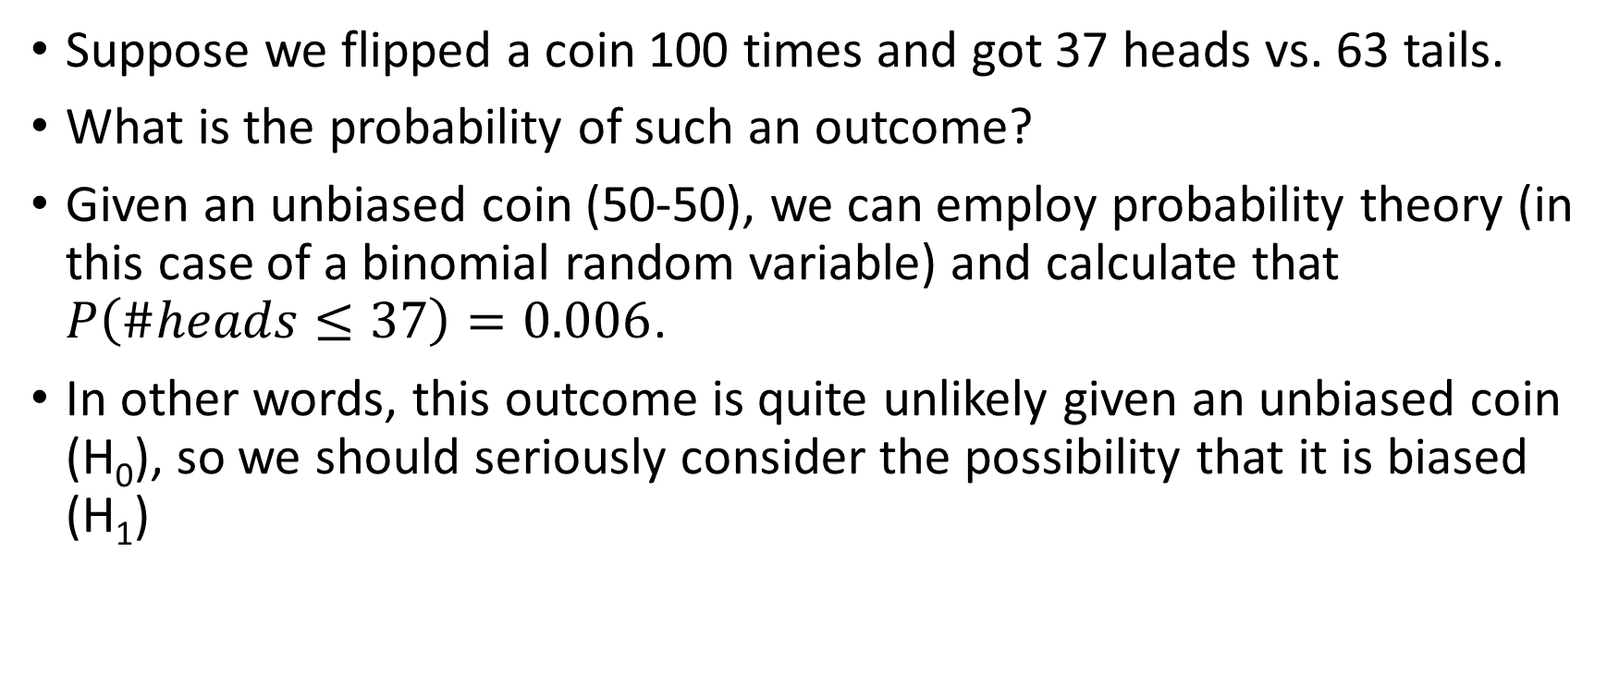
Is a coin biased?
Suppose we flipped a coin 100 times and got 37 heads vs. 63 tails.
What is the probability of such an outcome?
Given an unbiased coin (50-50), we can employ probability theory (in this case of a binomial random variable) and calculate that $P\left(\#heads≤37\right)=0.006$.
In other words, this outcome is quite unlikely given an unbiased coin (H₀), so we should seriously consider the possibility that it is biased (H₁)

Slide 10
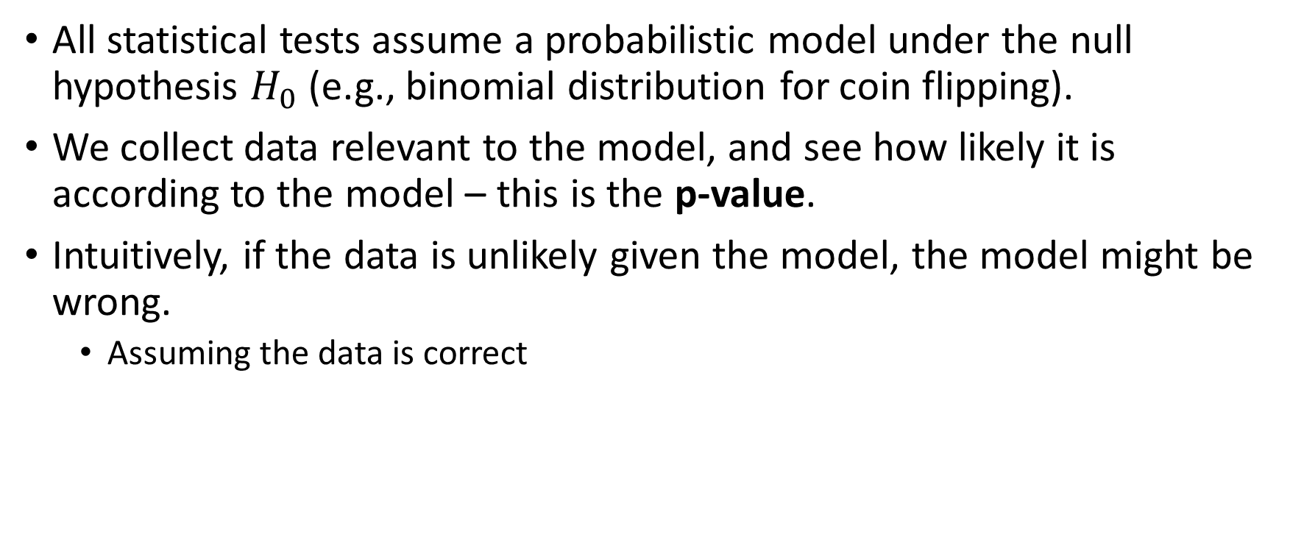
More generally,
All statistical tests assume a probabilistic model under the null hypothesis $H_{0}$ (e.g., binomial distribution for coin flipping).
We collect data relevant to the model, and see how likely it is according to the model – this is the p-value.
Intuitively, if the data is unlikely given the model, the model might be wrong.
Assuming the data is correct

Slide 11
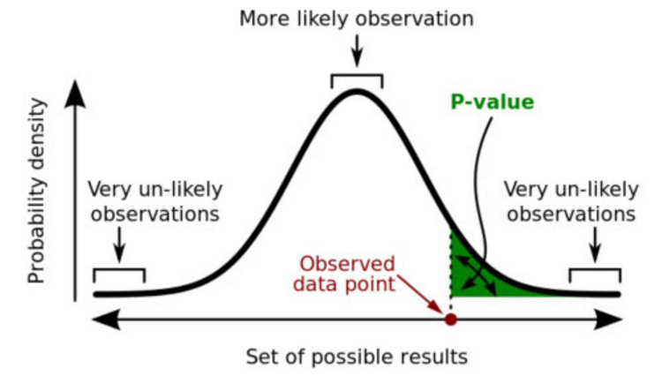
What does p-value actually mean?
It is merely a probability calculation of how likely observations are given the null hypothesis/model.
To be precise: how likely are any results that are at least as extreme as the observations
one- vs. two-tailed tests

Slide 12
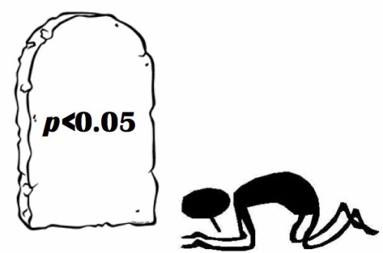
p-value is NOT:
A measure for how correct your theory is (low p-values don’t mean your alternative theory is true; high values definitely don’t mean the null hypothesis is true)
A measure for the strength of an association (with big enough dataset, even the weakest association will become very significant)

Slide 13
The case of mammograms
The incidence of breast cancer (among 40 year old women) is 0.13%.
A mammogram test has a sensitivity of 75% and specificity of 88%.
If you have the disease, the test will come up positive 75% of the time.
If you don’t have it, it will come up negative 88% of the time.
If a woman undertakes a mammogram and gets a positive result, what is the probability that she has breast cancer?

Slide 14
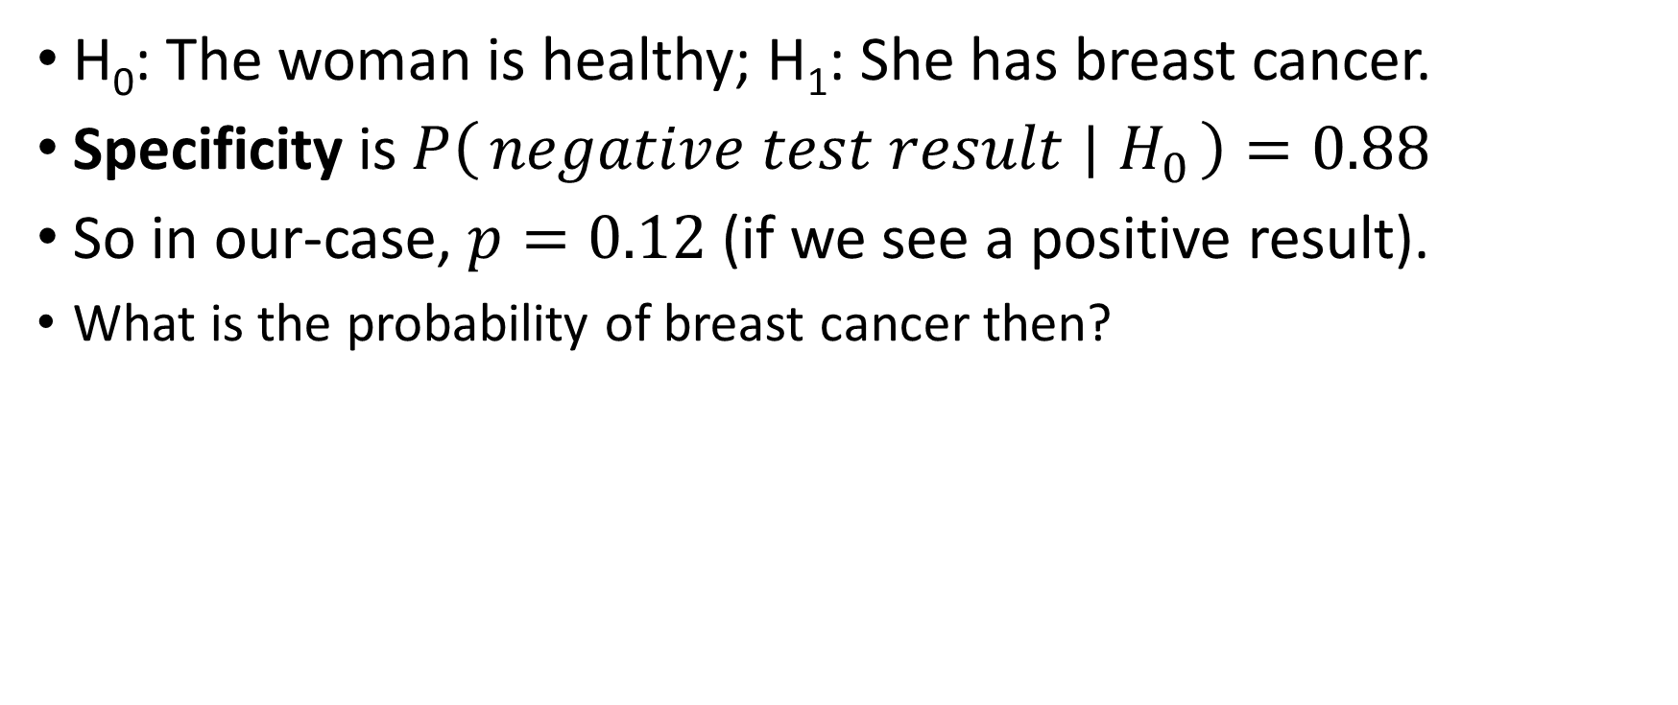
Let’s formalize it in the language of p-values
H₀: The woman is healthy; H₁: She has breast cancer.
Specificity is $P\left(negative test result ∣ H_{0}\right)=0.88$
So in our-case, $p=0.12$ (if we see a positive result).
What is the probability of breast cancer then?

Slide 15
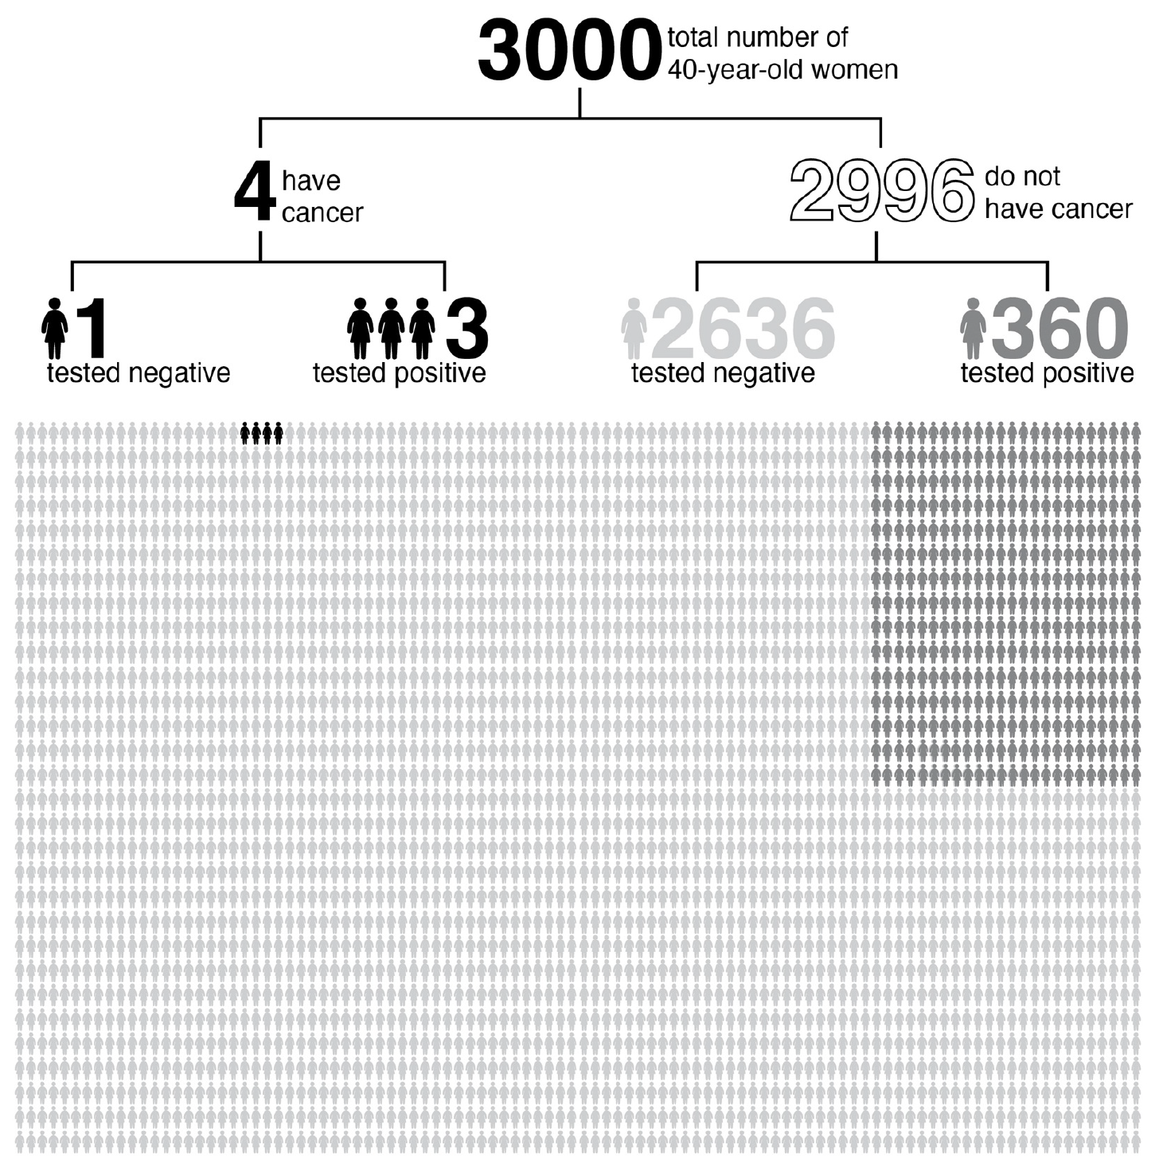
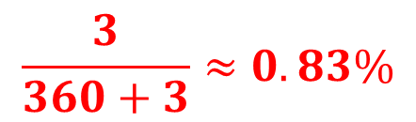
(0.13%)
(75% sensitivity)
(88% specificity)
$$\frac{3}{360+3}≈0.83\%$$

Slide 16
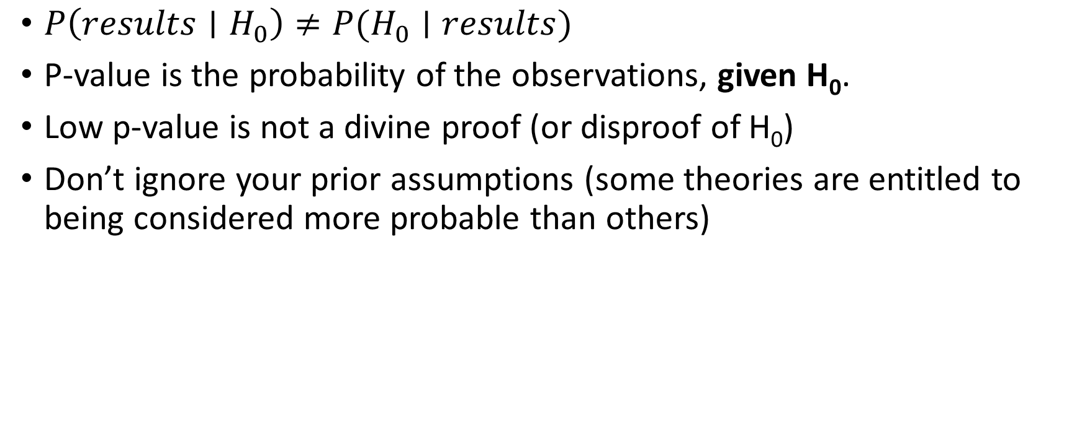
Moral of the story…
$P\left(results∣H_{0}\right)≠P(H_{0}∣results)$
P-value is the probability of the observations, given H₀.
Low p-value is not a divine proof (or disproof of H₀)
Don’t ignore your prior assumptions (some theories are entitled to being considered more probable than others)

Slide 17


Slide 18
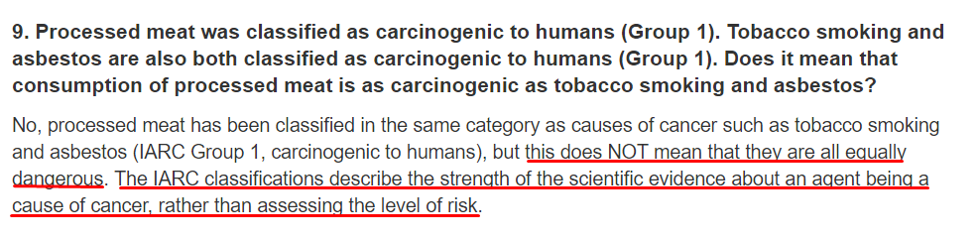
The truth about processed meat
From WHO’s website (http://www.who.int/features/qa/cancer-red-meat/en/):
In other words, popular media has confused significance and strength of association
Be smarter than Ynet editors!

Slide 19
Motivation & Introduction
P-values
Statistical tests
Numerical vs. numerical
Numerical vs. categorical
Categorical vs. categorical
Caveats
Extensions
Multiple hypothesis testing
Summary

Slide 20
Python and statistics
Two important libraries: scipy (statistical calculations) and statsmodels (more complex models)
Together they provide Python with reasonable statistical capabilities
Don’t forget citing them if you use these libraries for your published work
Still not as rich as R
It’s making progress though…

Slide 21
Plan
We’ll go over the most common statistical tests and demonstrate them in Python
We’ll focus on association tests (there are plenty)
The null hypothesis is straightforward: lack of association (i.e. independence of the variables)
Pay attention to the assumptions of each test

Slide 22
Input – variable types
The most important criterion for choosing the right test is variable types
Numerical
Gene expression level
Temperature
Number of offspring (even though it’s discrete)
Categorical
Tissue type
Cell cycle phase
Codon
Some can be either (a matter of choice)
Day of week

Slide 23
Assumptions of statistical tests
Assumptions about the data is the second-most important criterion for choosing the right test
Statistical tests often implicitly make many additional assumptions about the null hypothesis (e.g. normal distribution)
Sometimes, there is no justification to assume them
Very commonly neglected
At the very least, they should be kept in mind
Statistical tests almost always assume that your data points are i.i.d (independent and identically distributed)

Slide 24
Motivation & Introduction
P-values
Statistical tests
Numerical vs. numerical
Numerical vs. categorical
Categorical vs. categorical
Caveats
Extensions
Multiple hypothesis testing
Summary

Slide 25
Two numerical variables
Example: is the genome length of viruses associated with their physical size?
We might expect that large viruses will have bigger genomes
To test if there exists a simple linear association, we can use Pearson’s correlation

Slide 26
Pearson’s correlation
Input | Two numerical variables
Purpose | Testing linear correlation between the two variables
Null hypothesis | The two variables are linearly uncorrelated
Additional assumptions | Normal distribution (often robust to violation)
Limitations | Deals only with linear correlation Deals only with two variables
Implementation | scipy.stats.pearsonr(x, y)

Slide 27
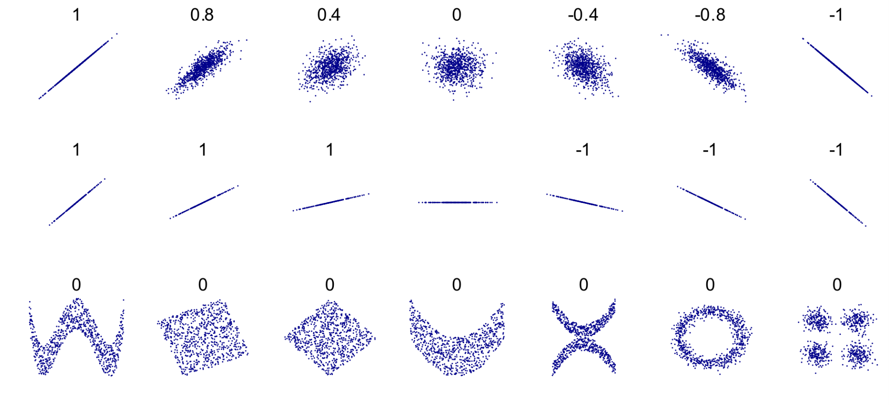
Pearson’s correlation coefficient (r)
A number between -1 (full negative correlation), through 0 (no correlation), to 1 (full positive correlation)

Slide 28
Scipy’s implementation
scipy.stats.pearsonr(x, y) returns (r, p-value) tuple
Assumes normal distributions
But should be fairly reasonable for large datasets even if this assumption isn’t met
Other p-value calculation methods exist (e.g. permutation tests)

Slide 29
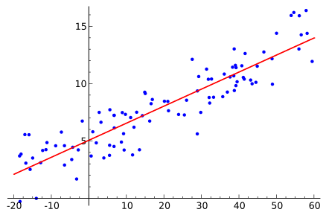
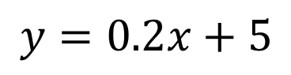
Can we predict Y given X?
Given that we found a linear correlation between Y and X, we can use a linear regression model to describe Y as a function of X.
$$y=0.2x+5$$

Slide 30
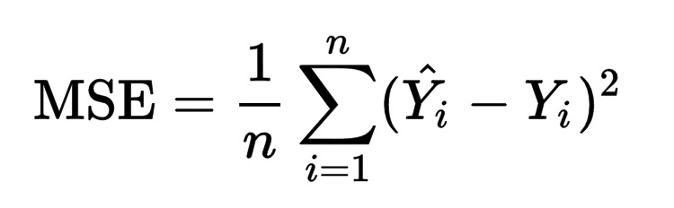
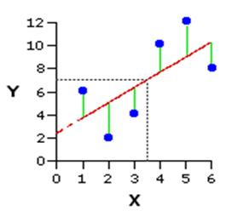
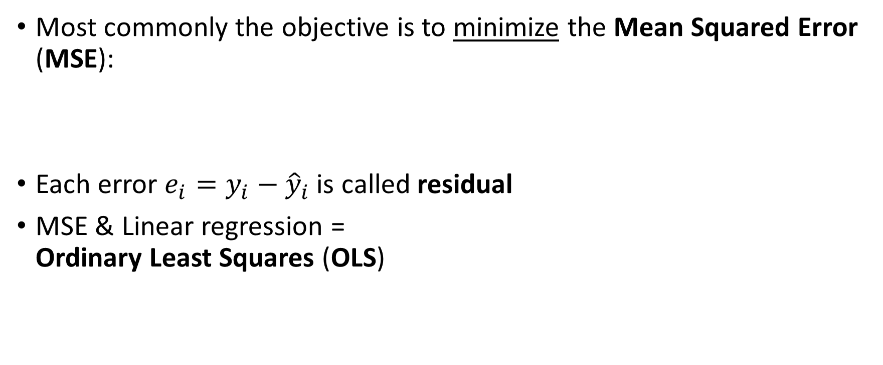
How regression lines come into the world
Most commonly the objective is to minimize the Mean Squared Error (MSE):
Each error $e_{i}=y_{i}−{\hat{y}}_{i}$ is called residual
MSE & Linear regression = Ordinary Least Squares (OLS)
prediction
observation

Slide 31
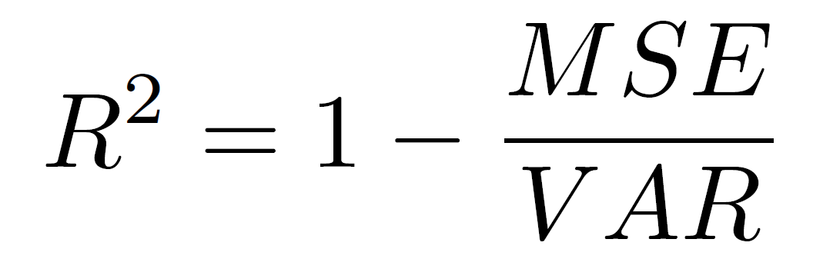
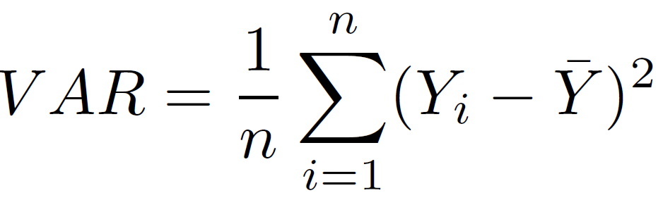
The infamous R²
MSE regression is commonly assessed by coefficient of determination:
(Where VAR is the variance of Y)

Slide 32
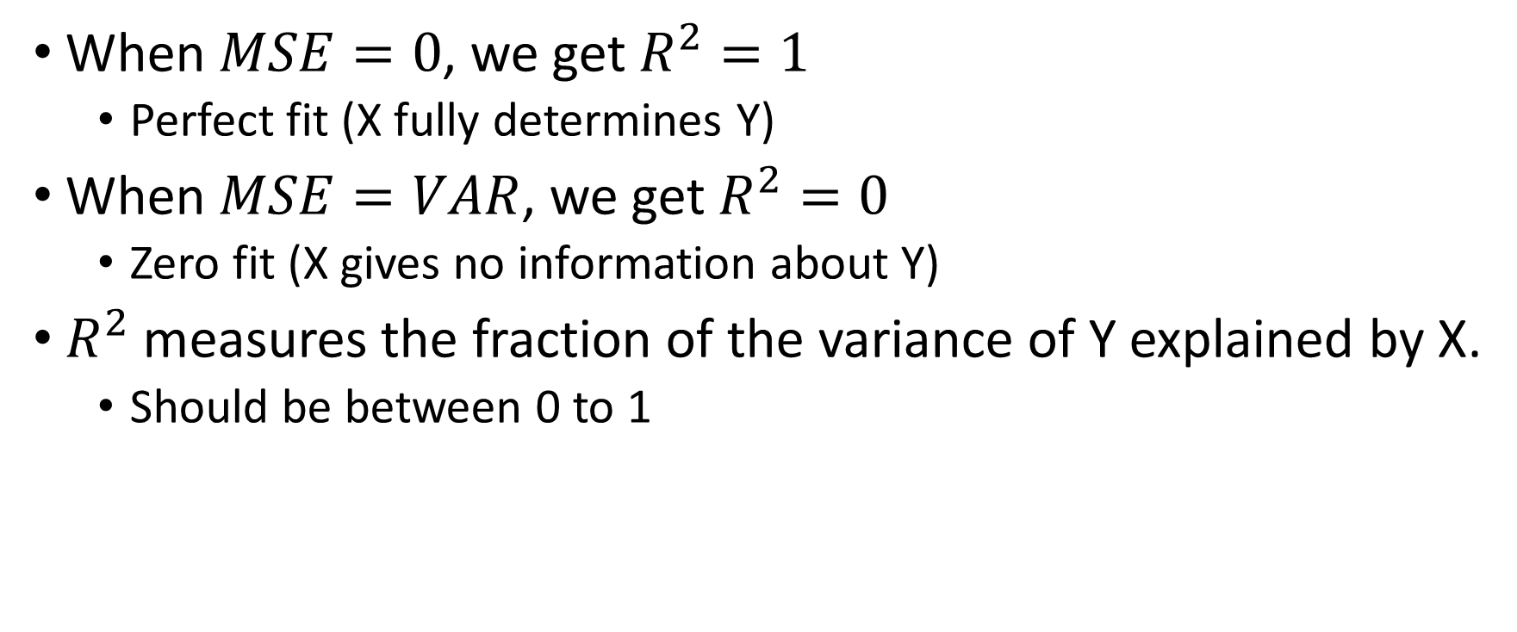
When $MSE=0$, we get $R^{2}=1$
Perfect fit (X fully determines Y)
When $MSE=VAR$, we get $R^{2}=0$
Zero fit (X gives no information about Y)
$R^{2}$ measures the fraction of the variance of Y explained by X.
Should be between 0 to 1

Slide 33
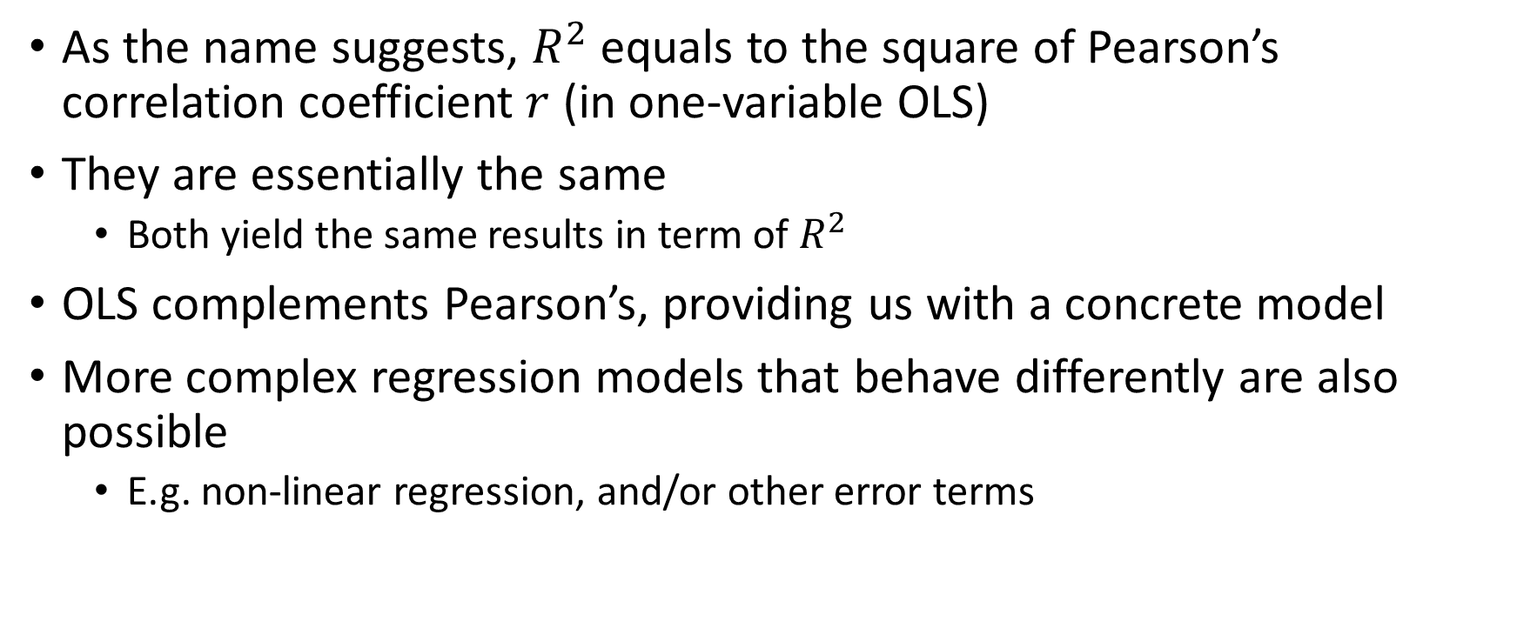
OLS vs. Pearson’s correlation
As the name suggests, $R^{2}$ equals to the square of Pearson’s correlation coefficient $r$ (in one-variable OLS)
They are essentially the same
Both yield the same results in term of $R^{2}$
OLS complements Pearson’s, providing us with a concrete model
More complex regression models that behave differently are also possible
E.g. non-linear regression, and/or other error terms

Slide 34
Regression analysis with statsmodels
statsmodels.api.OLS implements the standard regression model
Many other more advanced models are available
E.g. Robust Linear Models that are less affected by outliers

Slide 35
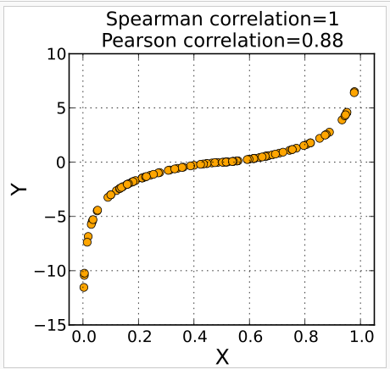
What if the correlation isn’t linear?

Slide 36
Spearman’s rank correlation
Input | Two numerical variables
Purpose | Testing monotonic correlation between the two variables
Null hypothesis | The ranks of the two variables are uncorrelated
Additional assumptions | None (non-parametric)
Limitations | Deals only with monotonic correlation Deals only with two variables
Implementation | scipy.stats.spearmanr(x, y)

Slide 37
It’s just the Pearson correlation between the rank values of the variables
Example: if x = [5.2, 2.1, -3, 4.2] and y = [66.1, 0, 10.12, 58] then rank_x = [4, 2, 1, 3] and rank_y = [4, 1, 2, 3].
scipy.stats.spearmanr(x, y) returns (ρ, p-value) tuple

Slide 38
Demonstration
Calculating Pearson’s and Spearman’s correlation with scipy
Regression analysis with statsmodels

Slide 39
Motivation & Introduction
P-values
Statistical tests
Numerical vs. numerical
Numerical vs. categorical
Categorical vs. categorical
Caveats
Extensions
Multiple hypothesis testing
Summary

Slide 40
Association between a categorical and a numerical variable
Example: Do viruses of different taxa have different genome lengths?
The simple case: only two categories (e.g. DNA vs. RNA viruses)
The question might become: are the means of the two populations significantly different?
The standard approach is then running t-test

Slide 41
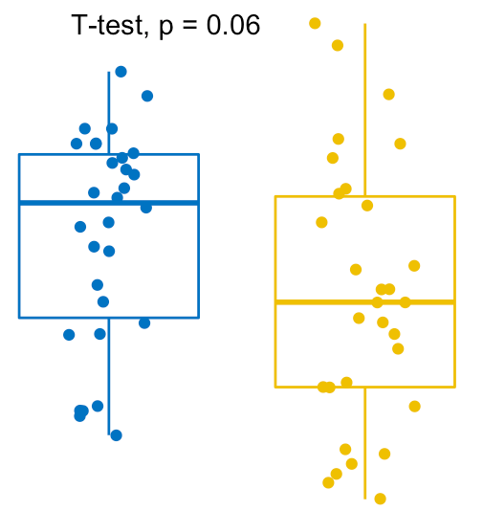
t-test of population means
Input | Two groups of numbers
Purpose | Compare population means
Null hypothesis | The two populations have the same mean
Additional assumptions | Normal distribution of means Equal variance
Limitations | Only compares means Unreliable for small sample sizes
Implementation | scipy.stats.ttest_ind(x, y)

Slide 42
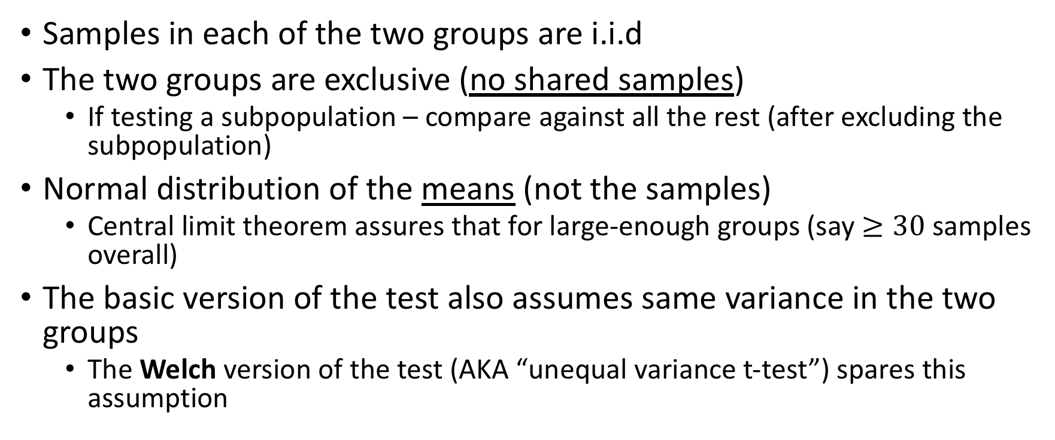
t-test assumptions
Samples in each of the two groups are i.i.d
The two groups are exclusive (no shared samples)
If testing a subpopulation – compare against all the rest (after excluding the subpopulation)
Normal distribution of the means (not the samples)
Central limit theorem assures that for large-enough groups (say $≥30$ samples overall)
The basic version of the test also assumes same variance in the two groups
The Welch version of the test (AKA “unequal variance t-test”) spares this assumption

Slide 43
Limitations
Note that t-test only compares the means of the two populations
Two populations with the same mean can still have very different distributions – t-test won’t detect that
Other tests (e.g. Kolmogorov-Smirnov) can be used instead

Slide 44
Implementation
scipy.stats.ttest_ind(x, y) returns (t-statistic, p-value) tuple
Use the flag equal_var = False for the unequal/Welch version

Slide 45
Mann-Whitney U test
Input | Two groups of numbers
Purpose | Compare rankings between the two populations
Null hypothesis | It is equally likely that a random sample from one population will be smaller or larger than a random sample from the second population
Additional assumptions | None (non-parametric)
Limitations | Blind to absolute values (cares only about ranking) Doesn’t compare all aspects of the distributions
Implementation | scipy.stats.mannwhitneyu(x, y, alternative = 'two-sided')
t-test and U-test are often interpreted the same: that one group is “bigger” than another

Slide 46
One-sample Kolmogorov-Smirnov test
Input | A groups of numbers and a reference distribution
Purpose | Test if the group is taken from the reference
Null hypothesis | The numbers are taken from the reference distribution
Additional assumptions | None (non-parametric)
Limitations | Can only reject origin distributions
Implementation | scipy.stats.kstest

Slide 47
Two-sample Kolmogorov-Smirnov test
Input | Two groups of numbers
Purpose | Test if the both groups come from the same distribution
Null hypothesis | Both groups are from populations with the same distribution
Additional assumptions | None (non-parametric)
Limitations | Hard to interpret (how do the distributions differ?)
Implementation | scipy.stats.ks_2samp(x1, x2)

Slide 48
More than two categories
t-test, U-test and Kolmogorov-Smirnov tests can compare the distributions of two populations
But what if the categorical variable has more than two values?
We can run multiple t-tests (one-vs-all for each group)
But then have to consider multiple hypothesis testing; we’ll lose some statistical power
Another approach: ANOVA (Analysis of Variance)

Slide 49
(one-way) ANOVA
Input | K groups of numbers
Purpose | Compare the means of all K populations
Null hypothesis | The means of all K populations are the same
Additional assumptions | Normal distribution of means Equal variance
Limitations | Won’t determine which group is different (need post-hoc tests)
Implementation | scipy.stats.f_oneway(x1, x2, x3, …)

Slide 50
Assumptions
Normal distributions of the means in all groups
Practically, ANOVA tolerates deviations from normality quite well
Same variance in all groups
Fairly robust against inequality of variances if differences aren’t too big
Independence of observations (within groups)
Groups are mutually exclusive

Slide 51
ANOVA extensions
There are more advanced version of ANOVA that mitigate these assumptions
Unfortunately Welch’s version, that deals with unequal variances, isn’t implemented in Python
Two-way ANOVA is an extension that examines the influence of two categorical independent variables on the continuous variable

Slide 52
Demonstration
t-test
U-test
Two-sample Kolmogorov-Smirnov test

Slide 53
Motivation & Introduction
P-values
Statistical tests
Numerical vs. numerical
Numerical vs. categorical
Categorical vs. categorical
Caveats
Extensions
Multiple hypothesis testing
Summary

Slide 54
Association between categorical variables
Examples:
Do proteins expressed in the brain tend to have PDZ domains?
Do different chromosomes tend to express different proportions of protein-coding to miRNA genes?
Are targets of specific miRNAs more abundant on specific chromosomes?
What genetic variants are associated with specific phenotypes?
GWAS is a complex field of study with some unique computational procedures

Slide 55
The simple case (2x2)
When each variable has two values
For example: when we study whether a binary risk factor is associated with a medical condition
A contingency table (summarizing the entire data) would look like:
 | Lung cancer | Healthy | Total
Smokers | 286 | 227 | 513
Non-smokers | 114 | 373 | 487
Total | 400 | 600 | 1000

Slide 56
Fisher’s exact test
Input | 2x2 contingency table
Purpose | Test if the rows and columns are associated
Null hypothesis | Hypergeometric distribution of cell values (i.e., no association)
Additional assumptions | None
Limitations | Only 2x2 (not practical for larger tables or very large sample sizes)
Implementation | scipy.stats.fisher_exact(table)
Important: as with other tests, all samples must be i.i.d.; categories must be mutually exclusive.

Slide 57
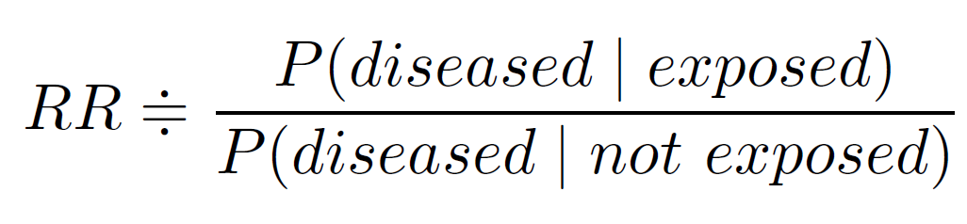
Risk-Ratio
The ultimate measure for the strength of the association is the Risk-Ratio (RR):
When the disease is rare (but the risk factor isn’t), it’s harder to design a proper cohort study that would give a reliable RR
Instead, it’s customary to use Odds-Ratio

Slide 58
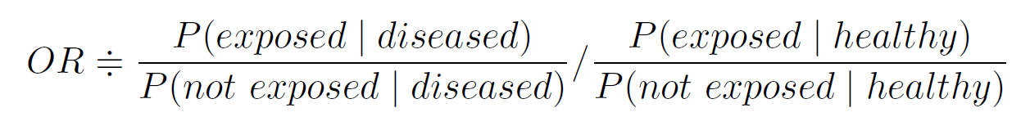
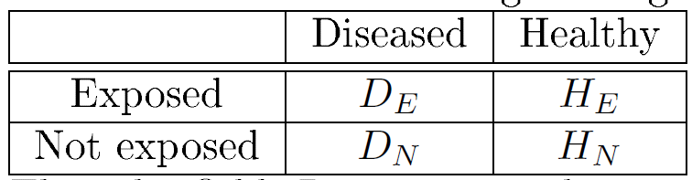
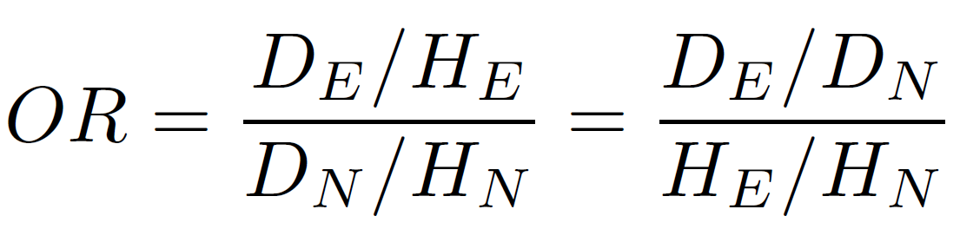
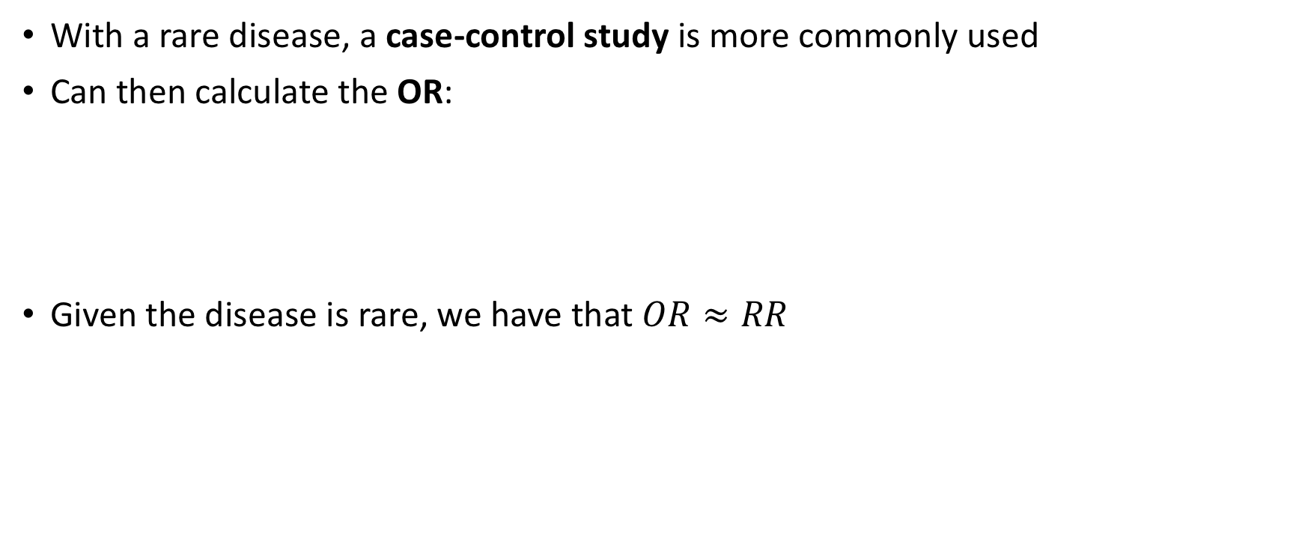
Odds-Ratio
With a rare disease, a case-control study is more commonly used
Can then calculate the OR:
Given the disease is rare, we have that $OR≈RR$
[OR is agnostic to transposing rows and columns]

Slide 59
NxM contingency tables
At least one variable has more than two values
 | Heavy smokers | Light smokers | Non smokers | Total
Lung cancer | 123 | 97 | 4 | 224
Colerectal cancer | 32 | 54 | 10 | 96
Melanoma | 34 | 23 | 14 | 71
Lymphoma | 14 | 14 | 1 | 29
Other cancers | 25 | 12 | 0 | 37
Total | 228 | 200 | 29 | 457

Slide 60
(Pearson’s) chi-squared test (of independence)
Input | NxM contingency table
Purpose | Test if the rows and columns are associated
Null hypothesis | Rows and columns are independent
Additional assumptions | Expected cell values can be approximated by normal distribution
Limitations | Won’t determine which categories are associated (need post-hoc tests)
Implementation | scipy.stats.chi2_contingency(observed)
Notes:
Note: instead of chi2 test, you can use multiple Fisher’s exact tests (with all 2x2 submatrices) and apply multiple testing correction.

Slide 61
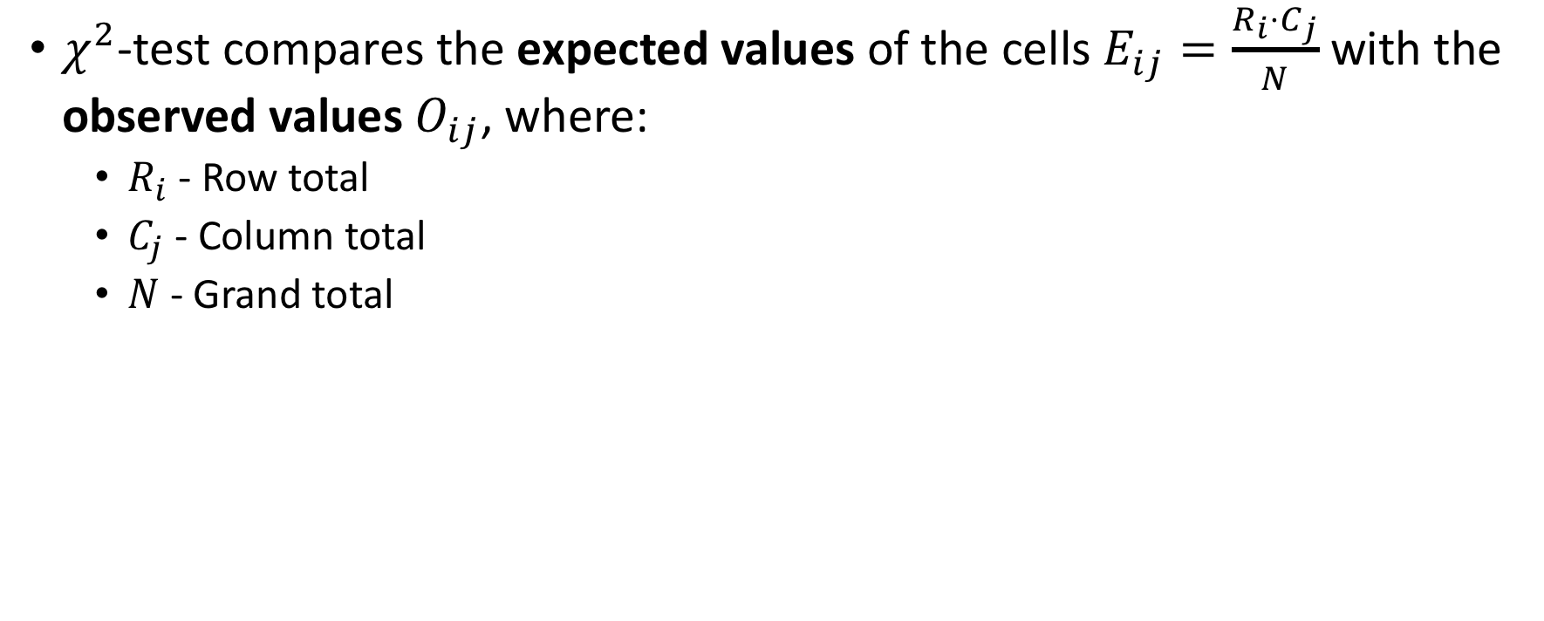
How it works
$χ^{2}$-test compares the expected values of the cells $E_{ij}=\frac{R_{i}⋅C_{j}}{N}$ with the observed values $O_{ij}$, where:
$R_{i}$ - Row total
$C_{j}$ - Column total
$N$ - Grand total

Slide 62
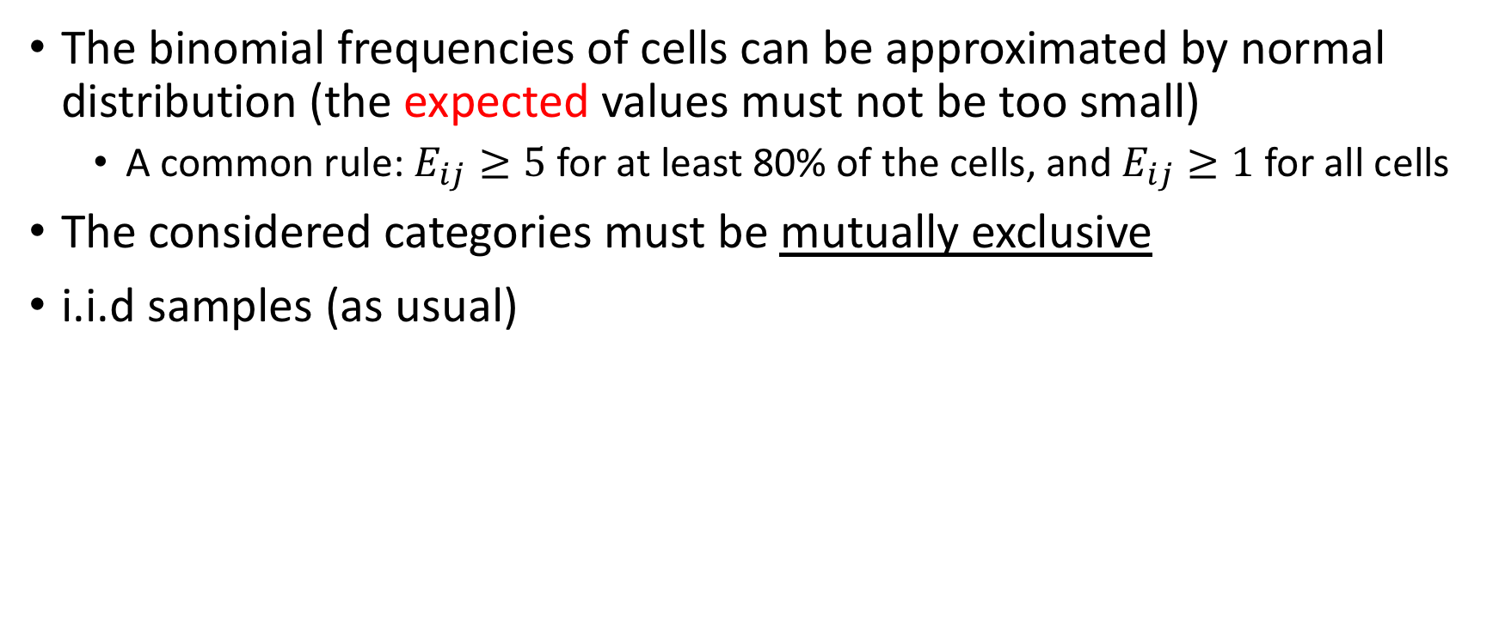
Assumptions
The binomial frequencies of cells can be approximated by normal distribution (the expected values must not be too small)
A common rule: $E_{ij}≥5$ for at least 80% of the cells, and $E_{ij}≥1$ for all cells
The considered categories must be mutually exclusive
i.i.d samples (as usual)

Slide 63
Demonstration
Fisher’s exact test & OR
Chi2 test

Slide 64
Motivation & Introduction
P-values
Statistical tests
Caveats
Extensions
Multiple hypothesis testing
Summary

Slide 65
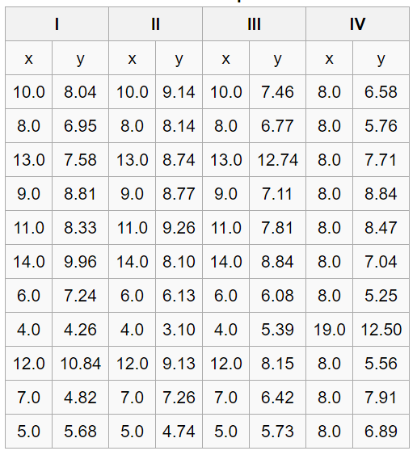
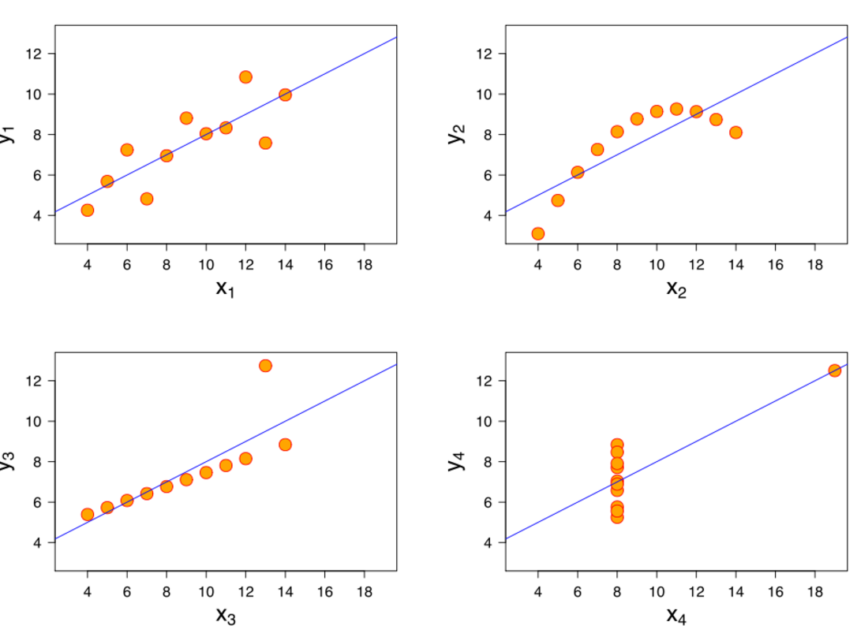
Anscombe's quartet
Do the following datasets look similar?

Slide 66
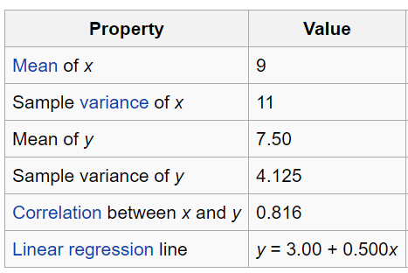
All 4 datasets have 11 points and nearly identical simple statistical properties
Constructed in 1973 by the English statistician Francis Anscombe to demonstrate:
The importance of actually looking at the data
The effect of outliers on statistical properties
Be skeptical of the notion that "numerical calculations are exact, but graphs are rough“

Slide 67
Both graphs and statistical analysis can be misleading
Combine the two, and you are less likely to get things wrong (but still might)
Most importantly – always retain some (but not too much) skepticism
It’s really not so difficult to abuse data and force it into supporting your claims

Slide 68
As a researcher, YOU are the defender of the null hypothesis!

Slide 69
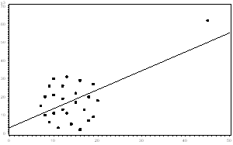
Dealing with outliers
Most statistical parameters and tests are highly sensitive to outliers
E.g. mean, variance, linear correlation, t-test, ANOVA
Some are robust
E.g. median, Spearman’s correlation, U-test
They can really mess your analysis up!

Slide 70
Deciding what to do with outliers is a tough choice
Requires judgement
If it’s obvious the outlier is an incorrectly entered or measured data point, drop it
If the outlier creates a significant association that wouldn’t exist otherwise, you shouldn’t report significance
If you choose to drop data, you must report that
If their presence changes your analysis, it should be noted
And you should seriously consider a more appropriate, robust test

Slide 71
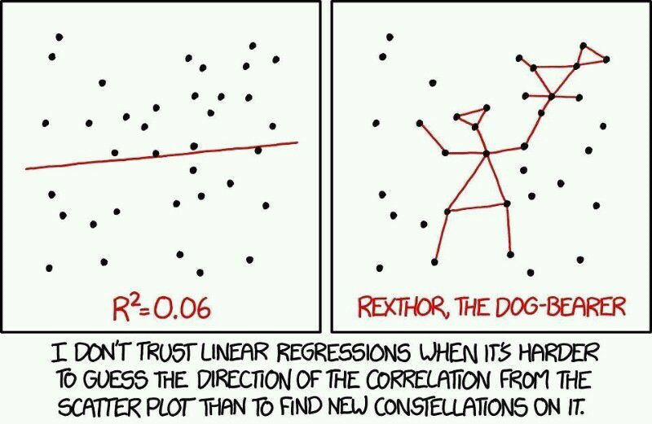
Beware of small effect sizes

Slide 72
Beware of sampling bias
Always ask yourself if the dataset you have is truly representative of the general population
What’s wrong with the following story:
Dr. Sloppy wanted to see if there existed a correlation between food poisoning and ankle sprains. He surveyed the patients at the St. Pearson Hospital and counted how many have none, either, or both conditions, and found significant negative correlation. Namely, patients who had one were less likely to have the other. Dr. Sloppy concluded that pathogenic food bacteria are protective from orthopedic trauma.

Slide 74
Another important caveat: correlation does not imply causation
Correlation/association tests can tell you that some variables X and Y are associated
This does not imply a causal connection in either direction
Perhaps a third variable Z affects both X and Y
Correlation is fully symmetric, causality isn’t
Inferring causality is very difficult without experiments
Randomized controlled trials are the gold standard
When you witness association, avoid jumping to conclusions

Slide 75
Data normalization
Example: we want to check whether brain-expressed genes are enriched with genetic variants
Problem: what if brain-expressed genes are longer or shorter than average? (very likely)
Should we normalize the number of variants by gene length?
When we normalize X by Y, we assume they should have linear relationship
E.g. maybe the number of expected variants is only sublinear with respect to gene length?
If possible, better to simply compare against genes of the same length

Slide 76
Still, statistics is a very powerful tool!
Do not let these caveats despair you
A careful statistical analysis can teach us a lot
Even if causal connections aren’t proven, association tests can spot interesting directions for future research
Statistical analyses provide an important layer in establishing claims

Slide 77
Motivation & Introduction
P-values
Statistical tests
Caveats
Extensions
Multiple hypothesis testing
Summary

Slide 78
Confidence Interval (CI)
Useful for combining effect size and significance
For example, a t-test has shown a significant difference in height between Swedes and Japanese. What is that difference?
A 95% CI of 3-5 cm means there is 95% probability of the difference being between 3 and 5 cm
Other examples:
Mean time of G-phase in E. coli is 15-40 minutes
1.25-1.56 OR between 50g/day of alcohol consumption and liver cancer

Slide 79
CI calculation in Python
Not always there exists an off-the-shelf implementation, but typically it’s quite easy to calculate
For example, in the case of OR see: http://sphweb.bumc.bu.edu/otlt/MPH-Modules/EP/EP713_RandomError/EP713_RandomError4.html

Slide 80
Nonparametric tests
Unlike parametric tests, nonparametric tests make no assumptions about data distribution (e.g. normal dist.)
The null hypothesis is less specific, so a rejection of H₀ justifies stronger conclusions
Typically it comes with some sacrifice to statistical power (i.e. harder to reject H₀ when it’s not true)
That’s the main reason people use parametric tests
Very useful with outliers or very small sample sizes
Most parametric tests have a nonparametric version, e.g.
Pearson’s vs. Spearman’s correlation
t- vs. U-test

Slide 81
Permutation tests
Another way to derive p-values with minimal assumptions
The idea: randomly shuffle the pairing between X and Y (many times)
p-value is then estimated to be the fraction of iterations in which we get a result at least as extreme as the obtained one (according to some statistic)

Slide 82
Example – protected gene region
Dr. Splinter was experimenting with his highly innovative Green Mutagen, observing its effects on the Ninja1 gene in turtles. Within Ninja1, which is 1000 bp long, he observed mutations at 15 different sites. To his great astonishment, he observed a 300-bp region of the gene without any mutations. Dr. Splinter wishes to know if such a “protected region” could have arisen by chance alone.

Slide 83
Code example

Slide 84
The downsides
Can be very computationally expensive for accurate estimation of low p-values (impractical for very low ones)
Results may change every time you run the test

Slide 85
What’s wrong with the following story?
An excited young student was looking for genes affected by an experimental drug. Looking at RNA-seq results of the entire mouse transcriptome, he found a gene that seemed dramatically overexpressed. He ran a t-test to validate his hypothesis, and found a significance level of 2.42E⁻⁵! The student reported the exciting finding to his supervisor.

Slide 86
Motivation & Introduction
P-values
Statistical tests
Caveats
Extensions
Multiple hypothesis testing
Summary

Slide 87
Multiple hypothesis testing
If the student had made his hypothesis prior to the experiment, it would have been fine, but post-hoc theorizing is cheating
p-value threshold of 0.05 means 5% chance for a false-positive result
If you run 20,000 independent experiments, expect ~1,000 positive results just by chance

Slide 88
Correction procedures
Two main approaches:
Bonferroni correction
False Discovery Rate (FDR)
Instead of 0.05, take a lower threshold to account for multiple tests
Equivalently, adjust the p-values into higher q-values

Slide 89
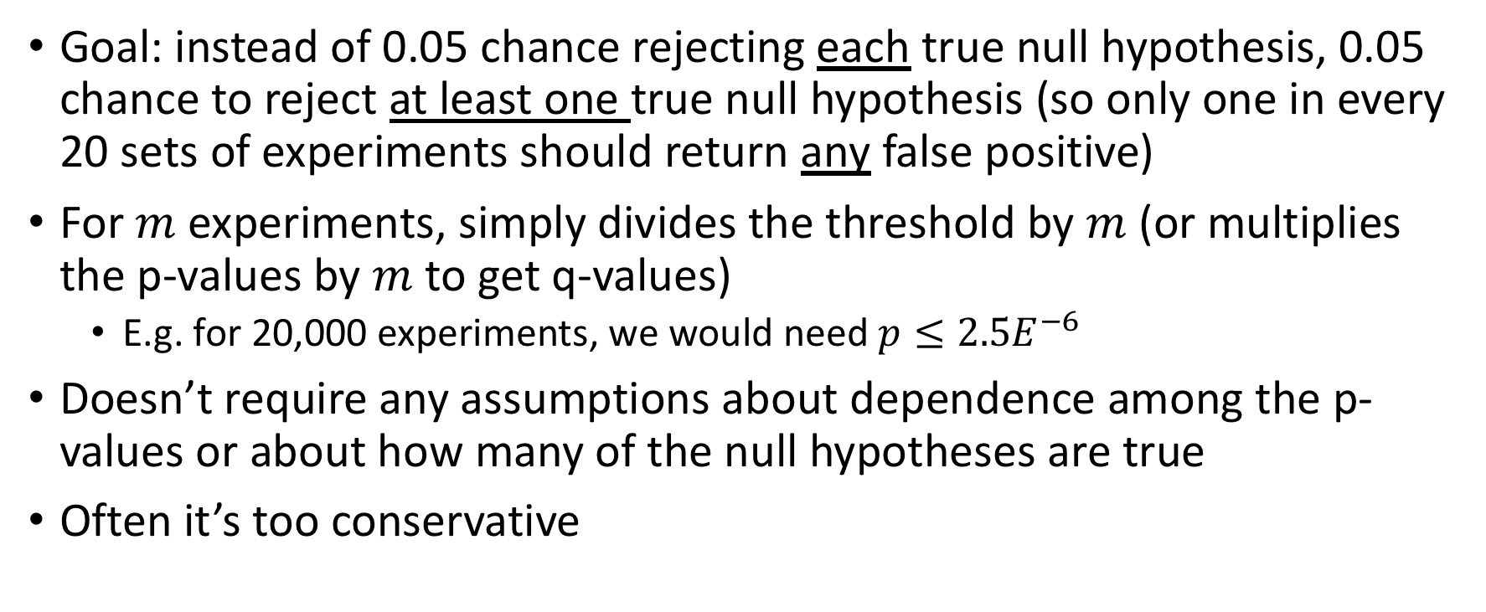
Bonferroni correction
Goal: instead of 0.05 chance rejecting each true null hypothesis, 0.05 chance to reject at least one true null hypothesis (so only one in every 20 sets of experiments should return any false positive)
For $m$ experiments, simply divides the threshold by $m$ (or multiplies the p-values by $m$ to get q-values)
E.g. for 20,000 experiments, we would need $p≤2.5E^{−6}$
Doesn’t require any assumptions about dependence among the p-values or about how many of the null hypotheses are true
Often it’s too conservative

Slide 90
FDR
Instead of controlling for the chance of any false “discovery”, control for their expected proportion (assuming that only positive results are reported)
I.e., the proportion of the false discoveries among the “discoveries”, not all hypotheses

Slide 91
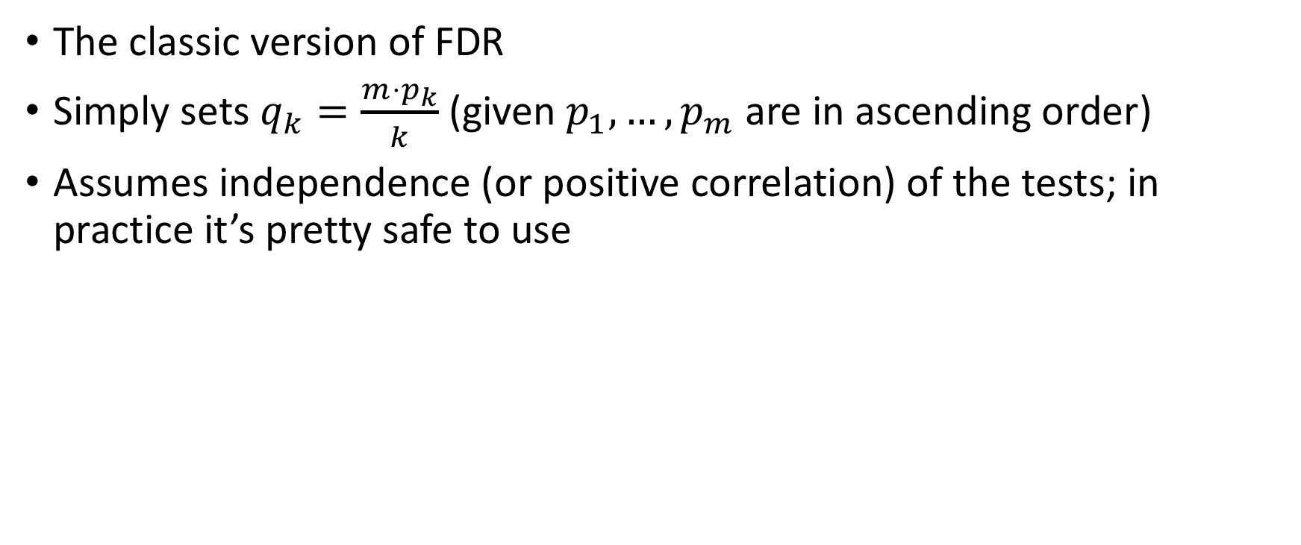
Benjamini–Hochberg (1995)
The classic version of FDR
Simply sets $q_{k}=\frac{m⋅p_{k}}{k}$ (given $p_{1},…,p_{m}$ are in ascending order)
Assumes independence (or positive correlation) of the tests; in practice it’s pretty safe to use

Slide 92
Benjamini–Yekutieli (2001)
Slightly more sophisticated version
Doesn’t assume anything about dependence
Usually too conservative

Slide 93
FDR can be non-intuitive
FDR actually provides the same degree of assurance as Bonferroni correction that there is indeed some effect
When all null hypotheses are correct, only one in every 20 sets of experiments should result any false discovery
So it’s a stronger tool to determine whether there’s any effect, but of course the overall number of false discoveries can be higher
Lower p-values are “punished” more than the higher ones
q-values are less interpretable than p-values

Slide 94
An important caveat
One should exclude known effects from an FDR analysis
It will increase the total set of discoveries, thus allowing more false discoveries

Slide 95
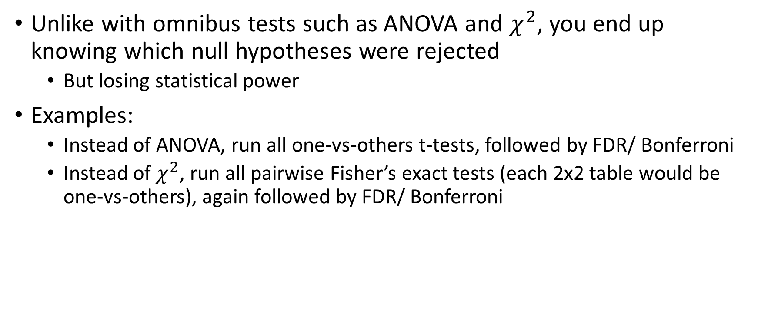
Multiple testing correction as an alternative to omnibus tests
Unlike with omnibus tests such as ANOVA and $χ^{2}$, you end up knowing which null hypotheses were rejected
But losing statistical power
Examples:
Instead of ANOVA, run all one-vs-others t-tests, followed by FDR/ Bonferroni
Instead of $χ^{2}$, run all pairwise Fisher’s exact tests (each 2x2 table would be one-vs-others), again followed by FDR/ Bonferroni

Slide 96
Statsmodels’ implementation
statsmodels.stats.multitest.multipletests(p-values, method = ‘<METHOD_NAME>‘, alpha = 0.05) returns (significance_boolean_array, q-values, _, _) tuple
Supports several methods, including:
'bonferroni‘
'fdr_bh‘ (Benjamini–Hochberg)
'fdr_by‘ (Benjamini–Yekutieli)
Code example

Slide 97
“File drawer effect”
AKA “publication bias”
Related to the “replication crisis”
“P-hacking”
The actual p-values matter (not just a story of “significant” vs. “not significant”)

Slide 99
Motivation & Introduction
P-values
Statistical tests
Caveats
Extensions
Multiple hypothesis testing
Summary

Slide 100
Summary
Two numerical variables:
Correlation (Pearson’s or Spearman’s)
Regression
Numerical vs. categorical variable:
Comparing means:
t-test or U-test (for 2 groups)
ANOVA (multiple groups)
Comparing distributions
Kolmogorov-Smirnov (for 2 groups)
Two categorical variables:
OR and RR (optionally with CI)
Fisher’s exact (2X2 table)
Chi-squared (any table, under more stringent assumptions)
Multiple testing correction:
Bonferroni
FDR (BH or BY)

Slide 101
Quiz
What statistical test would you use to find out whether:
Nucleus and cytoplasm proteins have different degradation rates
Sugar consumption is associated with cardiovascular diseases
Exercise is associated with life expectancy
Some GO annotation terms are enriched in the list of genes associated with ALS risk
Python programmers are more likely to publish highly-cited papers
Daily meditation routine helps preventing psychiatric disorders

Slide 102
A researcher wanted to find out which genes are overexpressed in cancerous lymphoctyes. She RNA-seqed 25 samples from a healthy patient and 25 samples from a diseased patient. What statistical test should she use?

Slide 103
What do you think of the following analyses?
1) A pharmaceutical company is studying the effect of a new drug in mitigating the symptoms of Alzheimer's disease. After testing a large number of patients in an RCT, t-test found a very significant association (p = 2.4E⁻¹¹) between administration of the drug and success in cognitive tasks. Impressed by the effectiveness of the drug, the company’s board of directors decides to further fund the research project.

Slide 104
2) A lab studies the effects of sugar-rich vs. fat-rich diets on mice. They designed a study where 10 mice were randomly divided into two groups of sugar- and fat-rich diets. During 5 days of experiment, several physiological measurements were taken from the mice, ending up with a total of 50 samples. After examining all taken measurements, they found, using t-test, that fat-rich diet is significantly associated (p = 3.2E⁻³) with elevated blood pressure.

Slide 105
3) A student wanted to find out whether proteins with PDZ domains are likely to have other domains as well. She built a contingency table with two columns (presence or absence of PDZ) and hundreds of rows for other domains, each cell counting the number of proteins with that combination. She iterated through the rows and ran Fisher’s exact test for each of the domains. She adjusted the p-values for multiple testing using FDR and found several significant domains.

Slide 106
4) A student wanted to determine whether 182 genes, predicted as targets of a specific miRNA, are associated with specific tissues. He built a contingency table for all human genes, with two columns (targets vs. non-targets) and a row for each tissue. He ran chi-squared test, after validating the expected frequencies were appropriate, and found an association.

Slide 107
5) A researcher wanted to know if protein phosphorylation is associated with cellular localization of proteins. She built a 2X2 contingency table with rows corresponding to phosphorylation status (phosphorylated or not) and columns corresponding to protein localization (nuclear protein or not). She iterated through all the reviewed UniProt records of Eukaryotes, and for each record iterated over its sequence. For each amino-acid, she increased the value of the corresponding cell in her table. In the end she ran Fisher’s exact test, and after obtaining a significant result, concluded that nuclear proteins have a tendency to undergo phosphorylation.

Slide 108
As a researcher, YOU are the defender of the null hypothesis!

Slide 109
That was just in a nutshell
There’s really an abundance of useful statistical tests and theory
If you are uncertain about how to analyze something properly and you can’t find good answers online, consult an expert

Slide 110
Relevant subjects we didn’t really discuss
Multivariate analysis (more than two variables)
We will talk about it in the next lesson
Causal inference
“The Book of Why” by Judea Pearl is highly recommended
Information theory
Provides a different perspective to describe data and distributions (e.g. entropy, mutual information, KL divergence)
Machine learning
Predictive models, clustering, etc.
Python is the dominant ecosystem in this domain (e.g. scikit-learn)
Tons of courses and online tutorials

Slide 111
“While it is easy to lie with statistics, it is even easier to lie without them”
-- Frederick Mosteller

